Slide 1
Dean’s Report to Faculty Council
Michael Good, M.D.
July 5, 2017

Slide 2
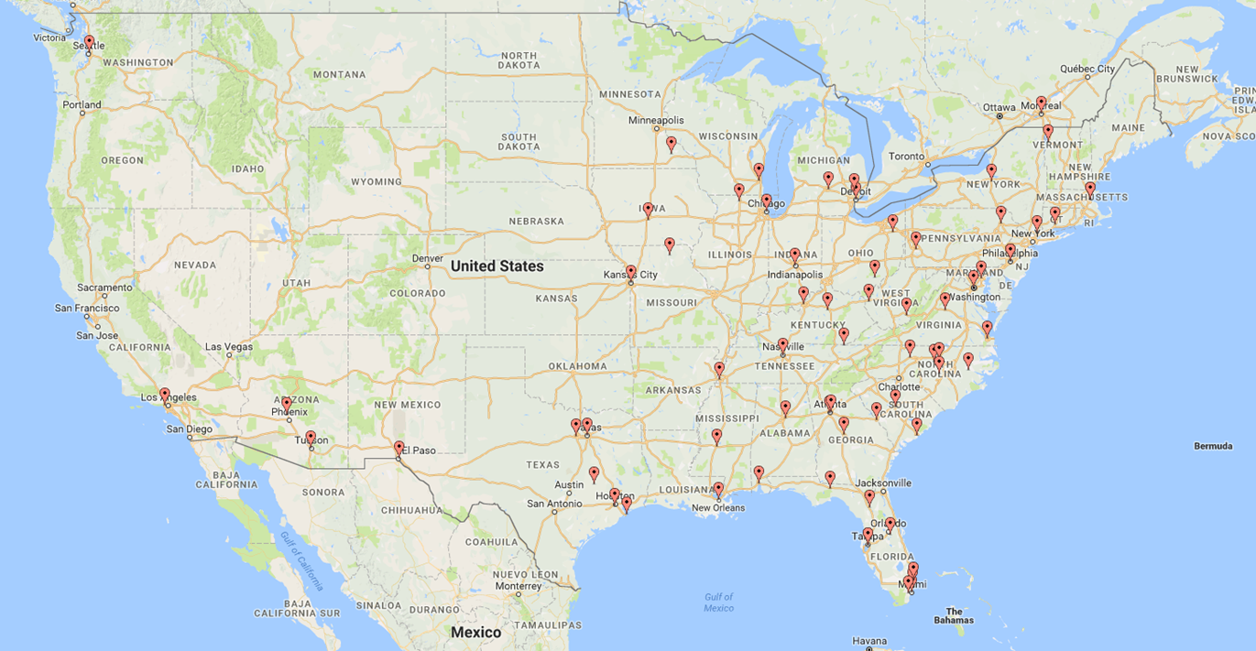
2017 Incoming Match (GNV)
220 first-year (intern) positions
63 from state of Florida
25 UF COM graduates
90% are graduates of US schools
“The UF College of Medicine welcomes 491 physicians who will start residency or fellowship programs in Gainesville, Orlando, Jacksonville and Pensacola on July 1. In addition to programs at UF Health in Gainesville and Jacksonville, we sponsor residency programs at Sacred Heart Hospital in Pensacola and Arnold Palmer Hospital for Children in Orlando to respond to the need to train physicians in our state and nation. We welcome 335 residents and fellows in Gainesville, 122 in Jacksonville, and 17 each at programs in Pensacola and Orlando.”

Slide 3
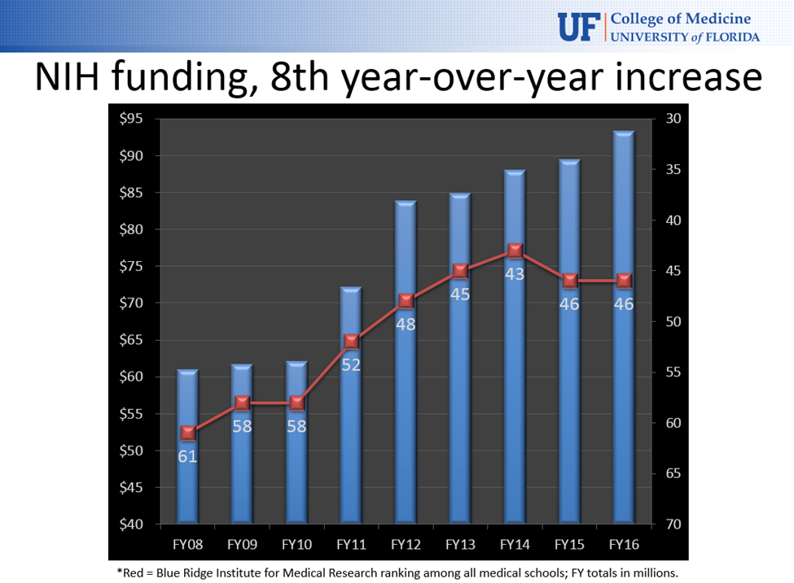
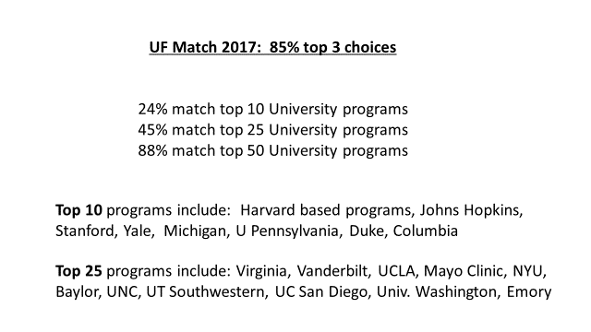
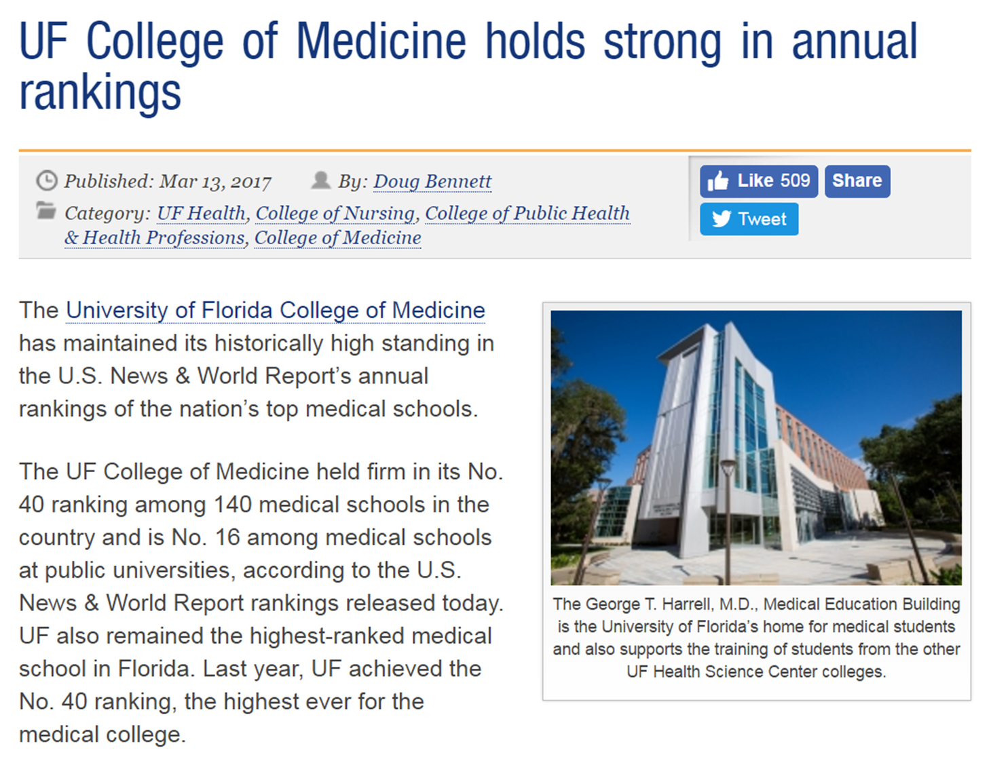
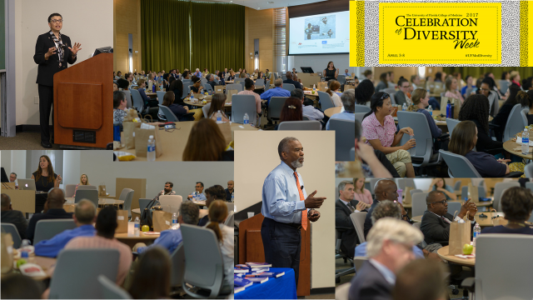
2016-2017: So much Good News

Slide 4
